Slide 1
GNSS Implementation Team
Takeyasu Sakai
JAPAN

Slide 2
Agenda 9: Update on Satellite Constellations and Plans
Status of Japanese QZSS and SBAS Programs
Presented by:
Takeyasu Sakai
National Institute of Maritime, Port and Aviation Technology, Japan

Slide 3
Introduction
QZSS (Quasi-Zenith Satellite System) Program
  Regional navigation service broadcast from high-elevation angle by a combination of three satellites on the inclined geosynchronous (quasi-zenith) orbit and a GEO.
  The first satellite “Michibiki” launched in 2010 has been continuously broadcasting GPS-like ranging signals and some augmentation signals.
  Begins the operation with 4-satellite constellation in April 2018, and 7-satellite constellation will follow in 2023.
  The mission of the operational QZSS:
    Positioning: Ranging and augmentation services including SBAS; and
    Messaging: Two-way mobile communication service for disaster and crisis management.
MSAS: Japanese SBAS Service
  Operational since 2007 in accordance with the ICAO standards.
  Continues operation with MTSAT-2 GEO.
    Replacement to the fully new system and new GEO in 2020;
    Integrated to the QZSS program.
    Upgrade for vertical guidance likely in 2023 with the 2nd GEO.

Slide 4
Part I
Status of the QZSS Program

Slide 5
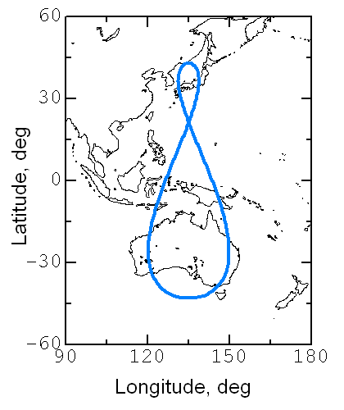
QZSS Concept
GPS/GEO
QZSS-IGSO
IGSOs
GEO
Broadcast signal from high elevation angle.
Applicable to navigation services for mountain area and urban canyon.
Augmentation signal from the zenith could help users to acquire and augment other GNSS satellite signals at any time.
IGSO (Inclined Geosynchronous Orbit) centered at 139E.
Eccentricity 0.075, inclination 41deg.
Additional GEO.

Slide 6

Mission
Mission 1: Positioning Services
  Ranging Service:
    Broadcasts GPS-like ranging signals on three frequencies (L1C/A, L2C, L5I/Q, and L1C) to improve availability of navigation in urban and mountain areas.
  Submeter Level Augmentation Service:
    SLAS on L1S
    Code-phase differential correction
    service for mobile users.
  Centimeter Level Augmentation Service:
    CLAS on L6D
    Carrier-phase differential correction
    service for precision applications.
Mission 2: Messaging Service
  Provides two-way mobile communication
  service for disaster and crisis management.
  Downlink short messages on L1 frequency.
  S-band two-way communication for emergency safety report.
(C)JAXA
QZSS
Orbit and Ground Track

Slide 7
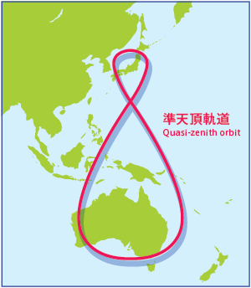
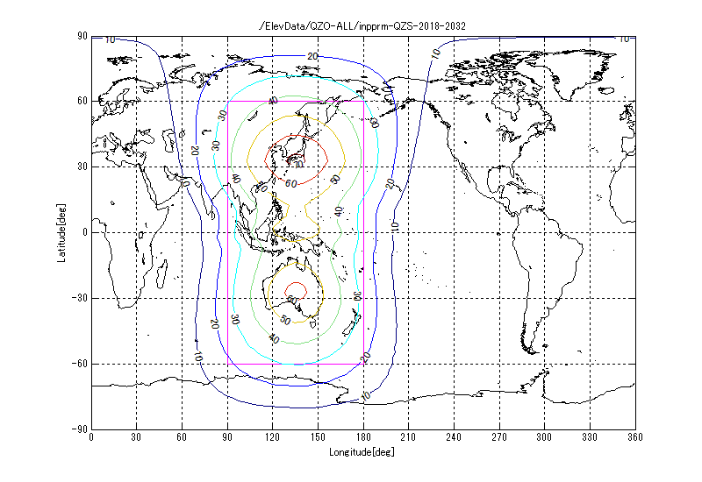
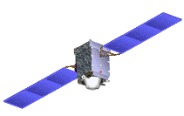
4-Satellite Constellation in 2020
QZS Visibility from Japan
・ 2 to 3 IGSOs above 20 deg. elevation;
・ At least 1 IGSO above 60 deg. elevation.
GEO @127E
・ Improved visibility
・ Additional services
Quasi-Zenith Orbit (IGSO)
Equator
Contour of QZSS Minimum Elevation Angle
Now we have the QZS-1 satellite on orbit.
Three additional satellites will be launched by mid-2017; 2 IGSO and 1 GEO.

Slide 8
QZSS Ranging Signals
Signal | Frequency MHz | Service | Compatibility | QZS-1 | QZS-2/4 | QZS-3
 |  |  |  | IGSO | IGSO | GEO
L1C/A | 1575.42 | Positioning | Complement GPS | ✓ | ✓ | ✓
L1C |  | Positioning | Complement GPS | ✓ | ✓ | ✓
L1S |  | Augmentation (SLAS) | QZSS Service | ✓ | ✓ | ✓
 |  | Messaging | QZSS Service | ✓ | ✓ | ✓
L1Sb |  | Augmentation (SBAS) | SBAS (L1) Service | — | — | ✓
L2C | 1227.60 | Positioning | Complement GPS | ✓ | ✓ | ✓
L5 I/Q | 1176.45 | Positioning | Complement GPS | ✓ | ✓ | ✓
L5S |  | Experimental Use (L5 SBAS) | SBAS (L5) Service | — | ✓ | ✓
L6D (D1) | 1278.75 | Augmentation (CLAS) | QZSS Service | ✓ | ✓ | ✓
L6E (D2) |  | Experimental Use (MADOCA) | QZSS Service | — | ✓ | ✓

Slide 9
Organization
Government of Japan
QZSS Project
SBAS Project
Office of National Space Policy
Cabinet Office
Ministry of Land, Infrastructure, Transport and Tourism
Contract (PFI)
Contract for satellites
Civil Aviation Bureau of Japan(JCAB)
QZS System Service Inc. (QSS)
System and Service
Provision
Contract for Ground
System Procurement
SBAS Facility
NEC Corp.
(NEC)
Mitsubishi Electric Corp. (MELCO)
I/F: Data and operational information
System Developers

Slide 10
Near-Term Plan
Fiscal Year | 2015 | 2016 | 2017 | 2018 | 2019 | 2020 | 2021 | 2022 | 2023 and Later
1st Michibiki
QZSS 4-Satellite Constellation
QZSS 7-Satellite Constellation
Replenish Satellite
Launch #1-R
Experiment/Test
Service
Launch #2,3,4
SBAS Service
Development/Launch (Additional 3 satellites)
Service

Slide 11
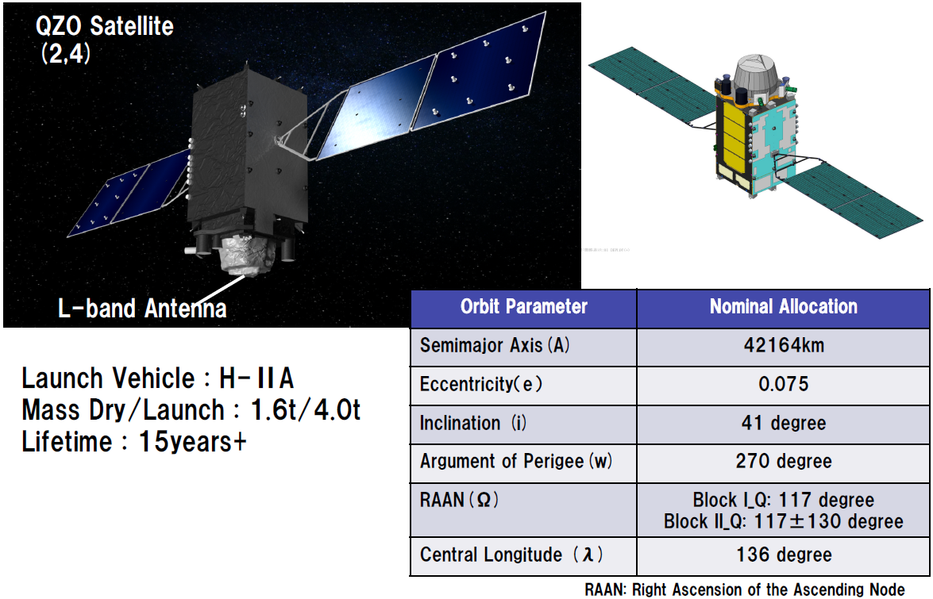
QZSS Satellites #2 and #4
139 degree
Satellite #2 Launch: June 1, 2017.

Slide 12
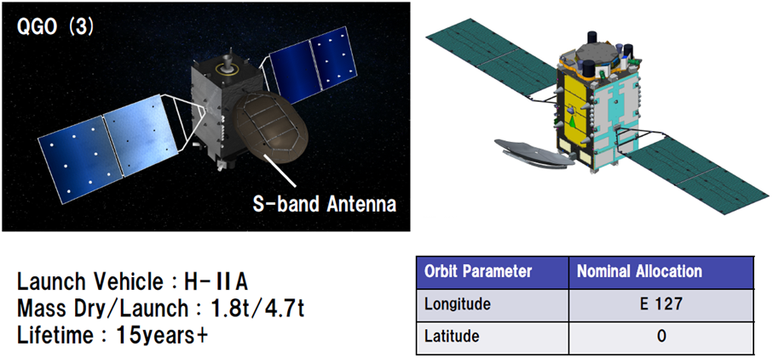
QZSS Satellite #3 (GEO)
Additional S-band antenna for two-way communication for emergency safety report.
L1b signal for SBAS service.

Slide 13
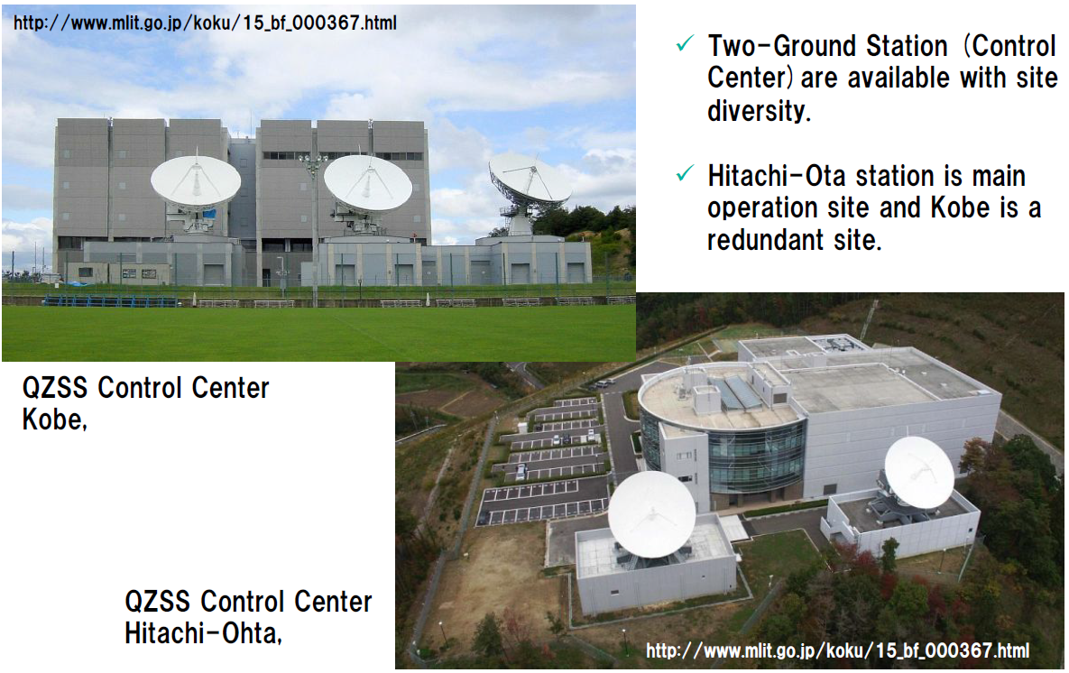
QZSS Master Stations
QZSS Control Center
Kobe (Backup)
QZSS Control Center
Hitachi-Ota (Primary)

Slide 14
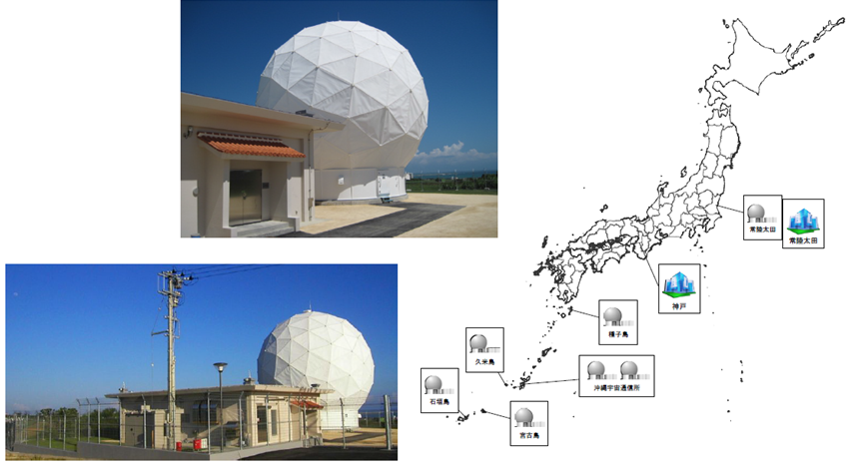
QZSS TTC Stations
Master
Stations
7 TTC (Telemetry, Tracking, and Command) stations: Most are at the southern part of Japan for satellite visibility.
All TTC stations were built and set operational by the end of 2016.

Slide 15
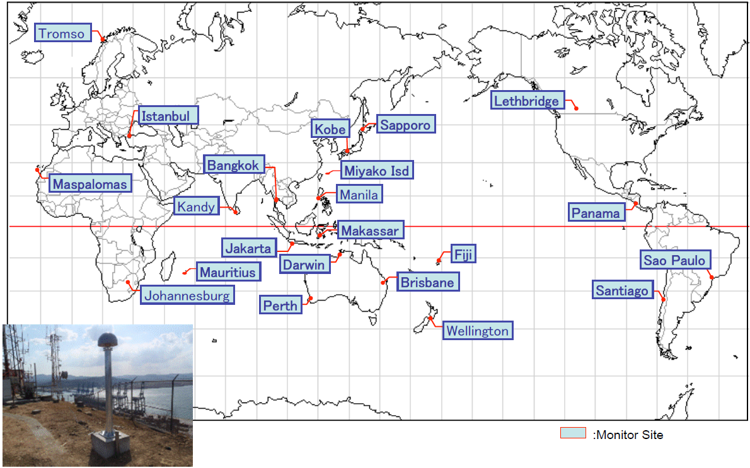
QZSS Monitor Stations

Slide 16
QZS-1 Signal Quality
Average -0.065 [m]
RMS 0.315 [m]
Percentage of time (|URE| ≦2.6 [m]) 100.0%
{Spec: ≧95%}
SIS-URE of QZS-1 L1C/A is 0.4m RMS level
Comparable to those for GPS Block IIRM and IIF satellites
5
4
3
Specification on SIS-URE = 2.6m (95%)
2
1
0
10 m
  For this month
  of January 2017,
  SIS-URE was just
  0.315m RMS.
-1
-2
-3
-4
-5
2017/01/01
2017/01/11
2017/01/21
2017/01/31
(Courtesy: (c) JAXA)
Since June, 2011, QZSS have provided navigation signals with good qualities, satisfying with their performance specifications, continuously.

Slide 17
Part II
MSAS: Japanese SBAS Program

Slide 18
MSAS Program
Beginning of SBAS Program in Japan:
  JCAB (Japan Civil Aviation Bureau) of Ministry of Land, Infrastructure, Transport and Tourism decided the development of its own SBAS in 1993.
  The system named MSAS, or MTSAT Satellite-based Augmentation System, was originally planned to be operational in 2000.
MSAS GEO Satellites:
  MTSAT (Multi-functional Transport Satellite): Aviation and weather missions.
    MTSAT works for AMSS and SBAS services for aviation.
  Launch of the MTSAT-1 was unfortunately failed in 1999.
    Spare satellite: MTSAT-1R was launched in February 2005.
  2nd GEO: MTSAT-2 on the orbit in February 2006.
Ground facilities:
  Consists of 2 MCS (KASC and HASC), 6 GMS, and 2 MRS.
Beginning Operation:
  Broadcast test signal since summer 2005.
  Finally, MSAS began its operation in September 27, 2007 after certification.

Slide 19
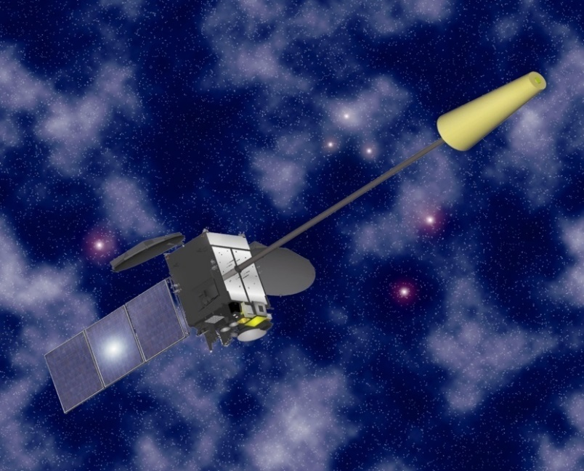
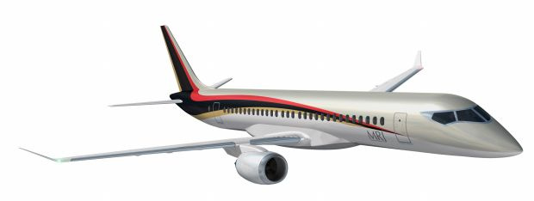
Current Status
MSAS GEO: MTSAT-2
MSAS: Japanese SBAS in operation.
  Operational since Sept. 27, 2007.
  Continue operation with 2 signals via 1 GEO.
    MTSAT-1R decommissioned in Dec. 2015.
    Hawaii and Australia MRS sites are
    removed in Feb. 2015.
Service for Air Navigation
  GPS Augmentation Information for RNAV,
  from En-route through NPA (RNP 0.3 performance).
    Within Fukuoka FIR.
    Only horizontal navigation due to ionosphere activities.
  NOTAM is available to MSAS users.
    Alert for Service Interruption.
    Alert for Predicted Service Outage.
Expanding Users
  Most small/regional jets equip SBAS-capable avionics.
  Japanese new regional jet, MRJ will also be capable of SBAS.
(c) Mitsubishi Electric Corp.
MRJ (Courtesy: MHI)

Slide 20

Current Configuration
GPS Satellites
MTSAT-2
Ranging Signals
Augmentation Signals
PRN137
6 GMS
in Japan
PRN129
Sapporo
GMS
Users
Kobe MCS
(and GMS)
Fukuoka GMS
Tokyo
GMS
Hitachi-Ota MCS
(and GMS)
Ground
Network
MSAS Monitor Stations
Naha GMS
1 GEO, 2 MCS (Master Control Station) and 6 GMS (Ground Monitor Station);
MTSAT-2 is broadcasting 2 signals from 2 MCS (PRN129 and PRN137);
Remote sites in Hawaii and Australia were removed from the original configuration.

Slide 21
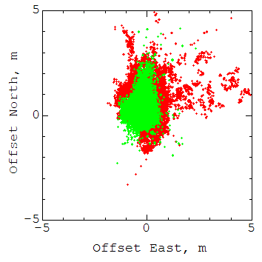
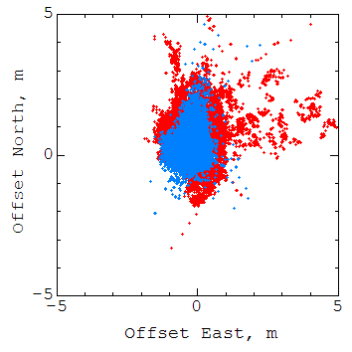
Correction Performance
Horizontal
0.722m RMS
GPS only
GPS only
Horizontal
0.717m RMS
MSAS PRN129
MSAS PRN137
GEONET 940058 (Takayama) 16/8/8-12 (5 days)
PRN129 and PRN137 Broadcast Signal

Slide 22
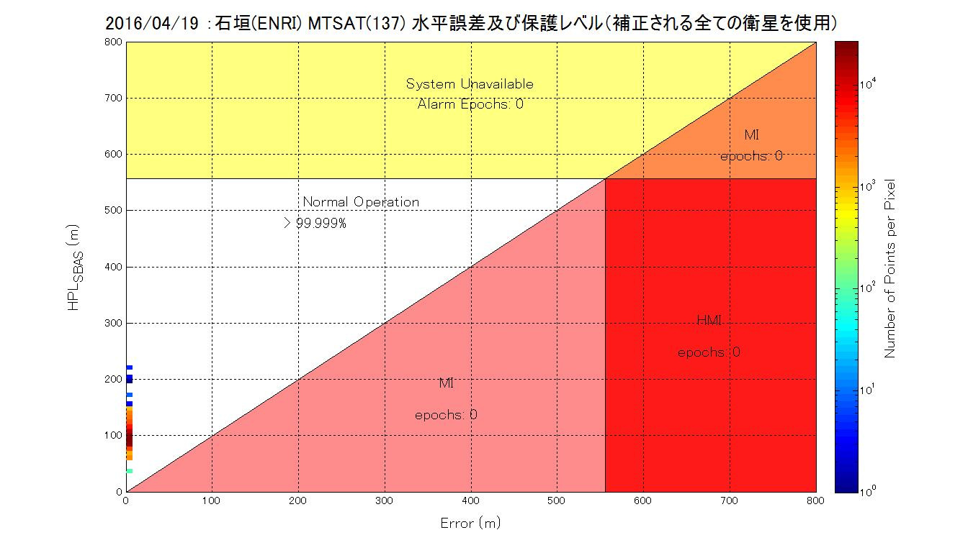
Integrity Performance
2016/4/19 Ishigaki Island MTSAT PRN137 Horizontal Error and Protection Level
Loss of Availability
Loss of
Availability
& Integrity
HAL=556m
Horizontal Protection Level (HPL), m
Normal
Operation
Loss of
Integrity
Loss of
Integrity
Actual Error, m

Slide 23
Continuous Operation
Current status:
  MTSAT-1R decommissioned in 2015. MTSAT-2 will be in 2020.
  2 MRS sites removed in 2015.
  The ground facilities need to be upgraded: It is difficult to maintain 20-year old equipment.
Replacement in 2020:
  MSAS V1 continues operation with a GEO (MTSAT-2) and 6 GMS by 2020.
    Decommission of MTSAT-2 planned in 2020.
  In 2020, MSAS V2 takes over the operation with a new GEO.
    Integrated to the QZSS program.
    The L1Sb signal of QZS-3 (GEO) will be used for MSAS service.
  MCS equipment will also be fully replaced at the same time.
  7 GMS will be added: Totally 13 GMS domestic.
  Performance will be similar with the current MSAS: Horizontal only.

Slide 24
Improvement Plan
Supporting vertical guidance: MSAS V2.1
  Vertical guidance: LPV operation.
  Need software upgrade:
    Adding GMS cannot overcome ionospheric effects.
    ENRI has been developed the improved algorithms for ionospheric correction.
  Will be supported in accordance with introduction of the 2nd GEO in 2023.
Dual-Frequency operation: MSAS V3
  Eliminates ionospheric effects dramatically.
    Robust vertical guidance (LPV and LPV-200) in the whole Japanese airspace.
  QZSS GEO will have the L5S signal useable for DFMC SBAS.
    DFMC: Dual-Frequency Multi-Constellation
  ENRI will begin DFMC SBAS experiment in 2018 with QZSS satellites.
    Early opportunity of the DFMC SBAS real signal from the space.
    Initial test by mid-2017 following launch of QZS-2 IGSO.
    Expects participation to this experiments from Asia Pacific Economies.

Slide 25
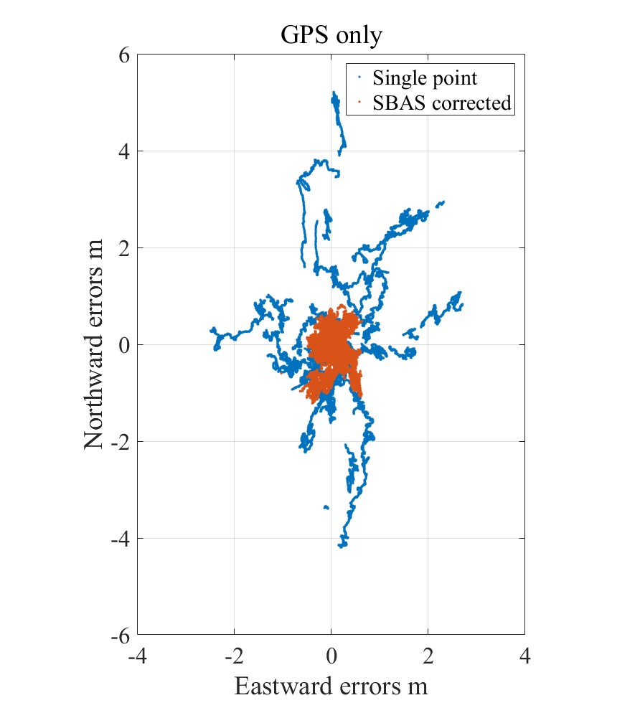
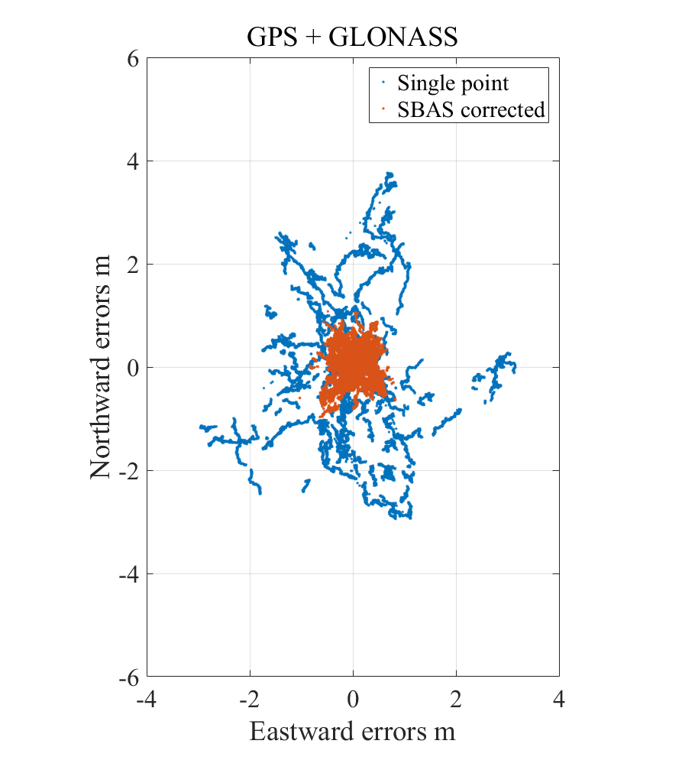
Prototype DFMC SBAS
Dual Frequency
DFMC L5 SBAS
Location:
GEONET 950369
(Wakayama)
Period:
2016/12/15 (24H)
SBAS corrections improve position accuracy in both modes of GPS and GPS+GLONASS.
SBAS messages are generated by the prototype DFMC SBAS developed
by ENRI, in accordance with the draft DFMC L5 SBAS standards.

Slide 26
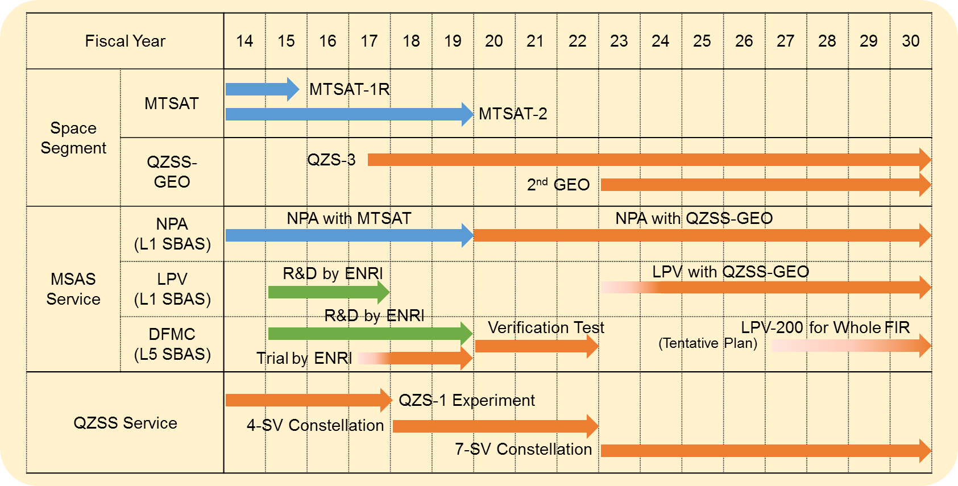
MSAS Evolution Plan
DFMC SBAS trial begins in 2018; Initial test by mid-2017.
Replacement to the new QZSS-based system in 2020.
LPV/LPV-200 upgrade likely in 2023 and DFMC SBAS implementation after that.

Slide 27
Conclusion
QZSS: Japanese Regional Satellite Navigation System
  Services: GPS-complement ranging, GNSS augmentation, and Messaging.
  4-satellite constellation including 3 IGSO and a GEO in 2018.
  Will be extended to 7-satellite constellation by 2023.
MSAS: Japanese SBAS Service
  An operational SBAS in accordance with the ICAO standards.
  Current service: Horizontal navigation (Enroute to NPA performance).
  Evolution plan:
    MSAS V2: Replacement to the fully new system and new GEO in 2020.
    MSAS V2.1: Upgrade for vertical guidance likely in 2023 with the 2nd GEO; Supporting LPV operations.
    Dual-frequency Multi-Constellation L5 SBAS trial since 2018 with real signals towards MSAS V3; Initial test by mid-2017.
Contact for more information:
Dr. Takeyasu Sakai <sakai@mpat.go.jp>
Electronic Navigation Research Institute
National Institute of Maritime, Port and Aviation Technology, Japan

